Slide 1
Distributed Systems
UNIT - 1

Slide 2
Preliminaries
UNIT - 1

Slide 3
What is an Operating System?
An operating system (OS) is a software layer to abstract away and manage details of hardware resources as a set of utilities to simplify application development
Applications
OS
Hardware

Slide 4
What is an Operating System?
An Operating System (OS) is an interface between a computer user and computer hardware.
An operating system is a software which performs all the basic tasks like file management, memory management, process management, handling input and output, and controlling peripheral devices such as disk drives and printers.

Slide 5
Functions of an Operating System?
Memory Management
Processor Management
Device Management
File Management
Security
Control over system performance
Job accounting
Error detecting aids
Coordination between other software and users

Slide 6
Course Aim
Provide an understanding of the technical issues involved in the design of distributed (operating) systems.
Understand the main principles underlying distributed systems: processes, communication, naming, synchronization, replication and consistency, fault tolerance, and security

Slide 7
Reference material for the UNIT
Text book:
Distributed systems: principles and paradigms
by AST & MV Steen
Distributed Operating Systems (Concepts & Design)
by PK Sinha

Slide 8
INTRODUCTION & MOTIVATION
UNIT - 1

Slide 9
Introduction
A Distributed System is a collection of independent computing units that appear to the users of the system a single computer.
The system contains machines, network and software.
Distributed systems are better as compared to centralized systems.

Slide 10
INTRODUCTION

Slide 11
Motivation
Grosch’s law states that computing power of a computing unit is proportional to square of its price.
Double the cost can yield four folds increase in power.
Moore’s law states that the number of transistors that can be put on a chip doubles in approximately 2 years.
Double the speed in 2 years with no additional cost.
Advancement in other fields is comparatively less.
Pollack’s rule states that performance increase is roughly proportional to square root of the increase in complexity.
Double the logic can only yield 40% gain.

Slide 12
Motivation
Butter’s law states that the amount of data coming out of an optical fiber doubles every 9 months.
Cost of transmitting a bit reduces by half every 9 months.
Neilsen’s law states that a high end user’s connection speed grows by 50% every year.
So, what can we infer from all this?

Slide 13
ADVANTAGES & DIS-ADVANTAGES
UNIT - 1

Slide 14
Advantages
Better price/performance ratio
Moore’s law vs Grosch’s law
Higher absolute performance
Low response time & higher throughput
Pollack’s rule
Inherently distributed applications
Higher reliability
Workload distribution avoids single point failure
Replication renders system fault tolerant.

Slide 15
Advantages
Incremental growth
Sharing resources
Scalability and flexibility

Slide 16
Dis-Advantages
COMPLEXITY
Designing software for distributed systems is complex.
SECURITY
Multiple issues exist in ensuring security while sharing resources
RELIABILITY
Reliability is hard to achieve to due underlying network and different hardware.

Slide 17
Reading Assignment
Distributed systems: principles and paradigms
by AST & MV Steen
Chapter 1
1.1. WHAT IS A DISTRIBUTED SYSTEM?
1.2. GOALS
1.2.1. Advantages of Distributed Systems over Centralized Systems
1.2.2. Advantages of Distributed Systems over Independent PCs
1.2.3. Disadvantages of Distributed Systems

Slide 18
Hardware and Software Concepts
UNIT - 1

Slide 19
Hardware Concepts
Distributed systems consist of multiple CPUs which can be connected in different ways.
Flynn’s classification
SISD
SIMD
MISD
MIMD

Slide 20
Hardware Concepts
Other relevant classification could be:
Multiprocessors
Same address space
Tightly coupled
Delay is short
Data rate is high
Exchange data via shared memory
Used as parallel systems working on a single problem

Slide 21
Hardware Concepts
Multicomputers
Separate address space
Loosely coupled
Used in distributed systems working on many unrelated problems
Each class can be further divided into 2 based on the network architecture
Bus based
Switched network

Slide 22
Bus-based multi processors & Computers
Bus-based multiprocessors
Coherent memory is employed but as more CPUs are added performance drops
We add cache to each processor to overcome the drop.
But it introduces incoherence
Example: (A process on CPU1, B on CPU2)
A reads X (from memory and caches it)
B reads X (from memory and caches it)
A updates X (in its own cache)
B reads X (from its own cache) [Problem as updated copy is not retrieved]

Slide 23
Bus-based multiprocessors
Solution
Write-through cache
A word written to cache is written to memory too [simple]
No bus traffic for cache hits for reads
Misses for reads and both hits/misses for writes has bus traffic
Still problem exists as B still reads from its own cache
Snoopy cache
A write to memory address present in cache, updates all the caches.
Bus-based multicomputers
Separate address space (for completeness)

Slide 24
Bus-based multiprocessors

Slide 25
Switched multiprocessors
Bus based architecture is not feasible for a system having microprocessors > 64.
Cross-bar switch
A mechanism by which memory can be accessed by many processors at a time.
Drawback
For n CPUs and n Memory modules, n² crossbar switches are required.

Slide 26
Switched multiprocessors

Slide 27
Switched multiprocessors
Omega network
Each switch has 2 inputs (from CPUs) and 2 outputs (to memory modules).
For n CPUs and n memory modules
Log ₂ n switching stages exist
n/2 switches per stage exist
Drawback
Delay incurred in switching

Slide 28
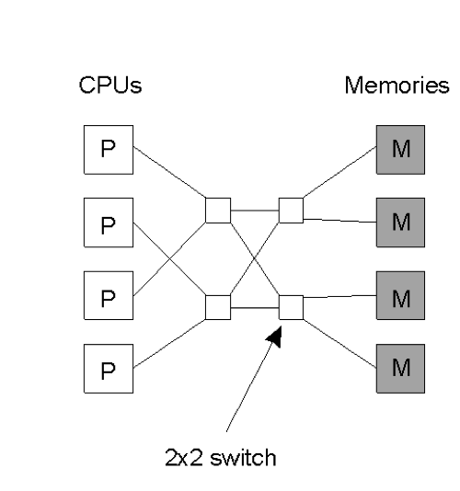
Switched multiprocessors

Slide 29
Switched Multicomputer
Grid
Hypercube
Hypercube is an n-dimensional cube
In a 3D cube,
vertex is a computer
Edge is a connection
Each computer is connected to 3 other CPUs

Slide 30
Switched Multicomputer
A) Grid
B) Hypercube

Slide 31
SOFTWARE Concepts
In presence of Multi-processor and multi-computer architecture, software can be either loosely coupled or tightly coupled.
Hence 4 possible combinations are possible (interconnections don’t matter)
Loosely coupled software on loosely coupled hardware
Network OS
Each system has high degree of autonomy

Slide 32
SOFTWARE Concepts
Loosely coupled software on tightly coupled hardware
Non-existent
Tightly coupled software on loosely coupled hardware
Distributed OS
Tightly coupled software on tightly coupled hardware
Multiprocessor supported system

Slide 33
SOFTWARE Concepts – Network OS

Slide 34
SOFTWARE Concepts – Distributed OS

Slide 35
A Comparison
Item | Distributed OS |  | Network OS | Middleware-based OS
 | Multiproc. | Multicomp.
Degree of transparency | Very High | High | Low | High
Same OS on all nodes | Yes | Yes | No | No
Number of copies of OS | 1 | N | N | N
Basis for communication | Shared memory | Messages | Files | Model specific
Resource management | Global, central | Global, distributed | Per node | Per node
Scalability | No | Moderately | Yes | Varies
Openness | Closed | Closed | Open | Open

Slide 36
Reading Assignment
Distributed systems: principles and paradigms
by AST & MV Steen
Chapter 1
1.3. HARDWARE CONCEPTS
1.3.1. Bus-Based Multiprocessors
1.3.2. Switched Multiprocessors
1.3.3. Bus-Based Multicomputers
1.3.4. Switched Multicomputers
1.4. SOFTWARE CONCEPTS
1.4.1. Network Operating Systems
1.4.2. True Distributed Systems
1.4.3. Multiprocessor Timesharing Systems

Slide 37
Design Issues
UNIT - 1

Slide 38
Design Issues - Transparency
As resources (both abstract and concrete) are distributed, multiple design issues arise.
Transparency
Provide a single virtual image
Difficult to achieve complete transparency
8 forms of transparency are identified by ISO:
Access transparency
User shouldn’t be able to recognize whether a resource is local or remote
System calls should be designed to make no such distinction

Slide 39
Design Issues - Transparency
Location transparency
Name Transparency: Name of the resource shouldn’t reveal anything about the physical location of the resource
User Mobility: User should be able to access a resource with same name from every machine
Migration transparency
Migration of resource is done to ensure reliability, enhance performance, etc.
No name-change
Automatically done in a user-transparent manner
IPC is not hindered

Slide 40
Design Issues - Transparency
Replication transparency
For performance and reliability
Existence of multiple copies should be unknown to user
The replication activity itself should be user-transparent
Concurrency transparency
Efficient usage of resources is done in sharing
Make user feel that he is the lone user of the system
Event ordering
Mutual exclusion
No starvation
No deadlock

Slide 41
Design Issues - Transparency
Performance transparency
Automatically reconfigure to improve performance
Load balancing by migration
Scaling transparency
Scale with demand without disrupting current activities
Failure transparency
Continue function even if some resources die, systems fail, or link is lost.
Complete failure transparency is not achievable.

Slide 42
Design Issues - Flexibility
Flexibility
Ease of modification
New requirements
Ease of enhancement
Refined service
Kernel architecture
Monolithic
Microkernel

Slide 43
Design Issues - Heterogeneity
Heterogeneity
Little Endian vs Big Endian
Word size
Network topology

Slide 44
Design Issues - Performance
Performance
Must be better or equal to the centralized system
Batch if possible
Reduce network traffic
Piggy backing messages
Cache whenever possible
Reduce network traffic
Minimize copying of data
Stack->buffer->kernel->network
Minimize network traffic
Process migration near to resource or communication process

Slide 45
Design Issues - Scalability
Scalability
Cope up with the increasing load
Avoid centralized components
Avoid centralized algorithms
Avoid centralized tables

Slide 46
Design Issues - Reliability
Reliability
A fault is a mechanic/algorithmic defect that may generate error
2 types
Fail-stop failure
Byzantine failure (difficult to deal)
Fault avoidance
Reliable hardware
Highly tested software

Slide 47
Design Issues - Reliability
Fault tolerance
Continue to work in presence of failure
Redundancy
Replicate critical hardware and software components
A system is supposed to be k-fault tolerant if it continues to work properly in presence of k-faults
K+1 replicas are required to deal with k fail-stop faults
2k+1 replicas are required to deal with k byzantine-faults

Slide 48
Design Issues - Reliability
Reliability
Fault detection & recovery
Atomic transactions
Stateless servers
Acknowledgments & timeout retransmissions
Security
Multiple sites
Insecure network

Slide 49
Reading Assignment
Distributed systems: principles and paradigms
by AST & MV Steen
Chapter 1
1.5. DESIGN ISSUES
1.5.1.Transparency
1.5.2. Flexibility
1.5.3. Reliability
1.5.4. Performance
1.5.5. Scalability
1.6. SUMMARY

Slide 50
Client Server model
UNIT - 1

Slide 51
Client-server model
Client: A client is a software entity that connects to servers and uses or consumes services provided by them. A client can but does not have to interface directly with a human user.
Server: A server is an instance of a particular service running on a single machine.
Service: A service is a software entity that runs on one or more machines. It provides an abstraction of a set of well-defined operations.

Slide 52
Client-server model

Slide 53
Client-server model
Layered protocols add considerable overhead in communication
Low bandwidth consumes high CPU power
High bandwidth consumes available bandwidth
Layered protocols don’t address problems of distributed OSes.
Client-server model is appropriate for an environment where
Group of cooperating processes exist
Servers and clients
Any machine is run any mix of servers and clients
Distributed system!

Slide 54
Client-server model
Request/Reply Protocol is appropriate because
Simplicity
No connection establishment is required prior to communication
Efficiency
Protocol stack is shorter
3 layers are enough
Physical, Data and RR
System calls are simple
Send() & Receive()

Slide 55
Design issues Addressing
Only machine number is used
Non-transparent and non-fault tolerant
Machine number plus process ID is used
Non-transparent and non-fault tolerant
Machine number plus ID for process is used
Clients broadcast their ID (local or global)
Broadcasting puts extra load on the network
Use name-servers
Centralized server may become bottle neck

Slide 56
Design issues Blocking vs non blocking primitives
Blocking/Synchronous primitives block the sending process until a message is completely sent.
Similarly, the receiving process is blocked by a blocking primitive until it receives the message.

Slide 57
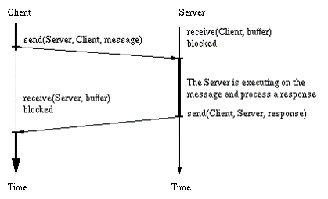
Design issues Blocking vs non blocking primitives

Slide 58
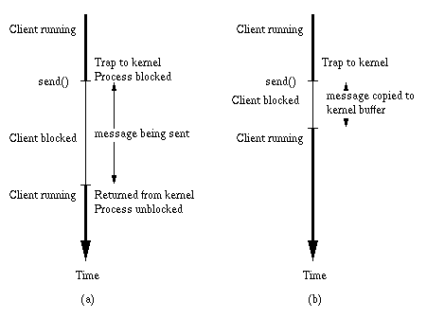
Design issues Blocking vs non blocking primitives
Non-blocking/Asynchronous primitives don’t block the sending or receiving process.

Slide 59
Design issues Blocking vs non blocking primitives
Though non-blocking primitives deliver performance but they have no way of knowing whether the ‘send’ was successful or not.
When to reuse the buffer?
As a solution, kernel may copy the buffer, and buffer gets free to be reused.
It degrades the efficient usage of memory.
Another solution could employ interrupts to inform when the buffer is free.
Highly complicated.

Slide 60
Design issues Buffered vs unBuffered primitives
In unbuffered primitives, the receiver must invoke receive() before the sender executes send().
This eliminates the need of buffer.
However, if it doesn’t, the message would be lost.
Buffering of message is done at kernel in buffered primitives.
No need to invoke receive() prior to send().
However, multiple send() can cause buffer to overflow.

Slide 61
Design issues RELIABLE vs unreliable primitives
How to make sure that message was sent successfully.
Assume send() is reliable [for completeness only].
Send acknowledgement from receiver to sender for the received message, and from sender to receiver for received reply.
For RR message, 2 ACK are sent.
2 Generals problem
REPLY acts as acknowledgement
No ACK for Reply

Slide 62
Reading Assignment
Distributed systems: principles and paradigms
by AST & MV Steen
Chapter 2
2.3. THE CLIENT-SERVER MODEL
2.3.1. Clients and Servers
2.3.2. An Example Client and Server
2.3.3. Addressing
2.3.4. Blocking versus Nonblocking Primitives
2.3.5. Buffered versus Unbuffered Primitives
2.3.6. Reliable versus Unreliable Primitives
2.3.7. Implementing the Client-Server Model

