Slide 1
Deadlocks in Distributed OS
Unit 3

Slide 2
What is a Deadlock?
A Deadlock is condition in which a set of processes can’t proceed further because the resource(s) necessary for progress of every process is held by some other process in the set.
‘pehle aap, pehle aap’

Slide 3
Conditions for Deadlock
Mutual exclusion.
No resource can be shared by more than one process at a time.
Hold and wait.
There must exist a process that is holding at least one resource and is waiting to acquire additional resources that are currently being held by other processes.
No preemption.
A resource cannot be preempted.
Circular wait.
There is a cycle in the wait-for graph.

Slide 4
Deadlock Modeling
Resource Allocation Graph
Nodes are resources/processes
Directed edges represent allocation or request
Existence of Cycle(s) signify DeadLock.
P1
P2
P1
P2
R1
R2
Request
Edge
Allocation
Edge
P3
P3

Slide 5
Deadlock Modeling
Wait-For-Graph (WFG)
Nodes are processes
Edges are requests for resources held by other processes
Existence of Cycle(s) signifies DeadLock.
P1
P1
P2
P3
P2
P3

Slide 6
How to handle?
Deadlock Prevention
Difficult as we have to violate one of the 4 necessary conditions
Deadlock Avoidance
Difficult as we need some prior knowledge of resources required to ensure a Safe-State.
Deadlock Detection (Our Focus)
Feasible, as all we have to do is to find cycles and rollback some allocation.
However, deadlock detection algorithms must satisfy 2 conditions:
No undetected deadlocks.
No false-deadlocks.

Slide 7
Deadlock Detection
Centralized Approach
A coordinator constructs wait-for graph (WFG) and checks for directed cycles.
Ho-Ramamoorthy Phase 1 Algorithm
Ho-Ramamoorthy Phase 2 Algorithm
Distributed Approach
WFG is spread over different sites.
Obermarck’s Algorithm
Chandy-Misra-Haas Algorithm

Slide 8
Ho-Ramamoorthy Phase-1 Algorithm
Each node has 2 tables
Resource table
Resources locked by or waited on by processes.
Process table
Processes that have locked or are waiting for resources.
Coordinator periodically collects these tables from each site.
Coordinator constructs a WFG from processes common to both the tables.
No cycle, no deadlock.
A cycle means a deadlock

Slide 9
Ho-Ramamoorthy Phase-1 Algorithm
Machine 0
Machine 1
Coordinator
Held by
Wants
R1
A
R1
C
A
R1
C
Wants
Held by
Held by
B
R2
R2
R3
R3
Wants
R3
B
Assume that B now asks for R3.

Slide 10
Ho-Ramamoorthy Phase-1 Algorithm
Machine 0
Machine 1
Coordinator
Coordinator
Held by
Wants
R1
A
R1
C
A
R1
C
A
R1
C
Wants
Held by
Held by
B
R2
R2
R3
R2
R3
R3
Wants
R3
B
B
Assume that C now releases R3 and then B asks for R3.
What if messages reach out of order?

Slide 11
Ho-Ramamoorthy Phase-1 Algorithm
Drawbacks
This algorithm can detect Phantom Deadlocks.
A phantom deadlock means the detection of a false deadlock, a deadlock that doesn’t really exist but is falsely detected.
This algorithm also incurs high storage and communication costs.

Slide 12
Ho-Ramamoorthy Phase-2 Algorithm
To overcome the problem of Phantom Deadlocks, the algorithm has 2 phases.
Phase-1 is same.
In Phase-2, on detection of a deadlock, the nodes are again queried.
in a hope that messages will arrive in order.
Centralized algorithms suffer from
Single point failures
Scalability

Slide 13
Distributed Algorithms
Path-pushing
Resource dependency information is disseminated through paths (in the graph).
Edge-chasing
Special messages or probes are circulated along edges of WFG.
Deadlock exists if the probe is received back by the initiator.

Slide 14
Obermarck’s PATH Pushing Algorithm
Each site maintains a local Wait-For Graph.
A virtual node ‘x’ exists at each site that represents external processes.
An edge (pi, px) is added if process pi is waiting for a resource held by a process in another site.
An edge (px, pj) is added if process pj in another site is waiting for a resource held by a process of this site.
When the deadlock detection process begins,
If a cycle is found at a site which doesn’t involve the external node ‘x’ it means the deadlock exists within the site and can be resolved locally.
If there exists a cycle involving ‘x’, it means a deadlock is possible that contains processes from other sites and hence they should be intimated.

Slide 15
Obermarck’s PATh Pushing Algorithm
1
3
4
2
1
3
5
Node S1
Node S2

Slide 16
Obermarck’s PATH Pushing Algorithm
1. At S1, p1 is waiting for a resource held by p3 in S2,
(p1, px)
2. At S1, p3 is a process in S2 waiting for resource
held by a process in S1, (px, p3)
3. If a cycle exists but doesn’t involve x, then it can
be solved locally.
4. A Cycle (px, 3, 2, 1, px) exists and hence the
message is forwarded to Site S2.
x
1
3
4
2
1
3
Node S1
4
2
1
3
5
Node S1
Node S2

Slide 17
Obermarck’s PATH Pushing Algorithm
1. At S2, p3 is waiting for a resource held by p2
in S1,
(p3, px)
2. At S2, p1 is a process in S1 waiting for
resource held by process in S2,
(px, p1)
3. When the message is received by S2, the
edges within the received cycle that don’t
involve px are added.
4. Cycle (px, 3, 2, 1, px); thus (3,2) and (2,1) is added.
5. Now a cycle (without x) exists and should
be resolved.
x
1
3
5
2
Node S2

Slide 18
Obermarck’s PATH Pushing Algorithm
It is used for databases where transactions lock and wait on resources.
The downside of the algorithm is that
Multiple deadlock detections may be initiated simultaneously, which results in multiple recoveries leading to overkill.
Extra Message Overhead.
Detection is complicated wherein the processes span over many nodes.

Slide 19
Chandy-Misra-Haas Edge Chasing algorithm
It uses a probe message to detect the presence of cycles.
The blocked process sends the probe message.
The message contains three variables.
The Id of the blocked process,
The Id of the process sending the message, and
The Id of the process to which the message was sent.
The probe is forwarded to the processes holding the requested resources and continues that way.
If the blocked process receives its own probe, it means that a cycle exists and hence the deadlock also exists.

Slide 20
Chandy-Misra-Haas Edge Chasing algorithm
(0,8,0)
Machine 0
Machine 1
Machine 2
(0,3,4)
(0,4,6)
(0,2,3)
4
6
8
0
1
2
3
(0,6,8)
5
7
(0,3,5)
(0,5,7)
(0,0,1)
(0,1,2)
0 is locally dependent upon 1
2 is remotely dependent upon 3

Slide 21
Reading Assignment
Distributed systems: principles and paradigms
by AST & MV Steen
Chapter 3
3.5. DEADLOCKS IN DISTRIBUTED SYSTEMS
3.5.1. Distributed Deadlock Detection
Centralized Deadlock Detection
Distributed Deadlock Detection
3.5.2. Distributed Deadlock Prevention
3.6. SUMMARY

Slide 22
Threads
Unit 3

Slide 23
What is a Process?
We are multi-tasking systems.
Computers achieve this via the notion of a Process
Each process represents a distinct job.
The scheduling algorithms let a process run for some time and then preempt it to allow other processes to run.
During preemption the context of the current process is saved and the context of old process is restored for execution.
However, processes are heavy-weight.

Slide 24
What is a Process?
Heavy-Weight Process
They are normal processes that don’t share memory with other processes.
In other words, they have private CODE, STACK, DATA, PC, etc.
Lets save their context?
What about shared variable?
Process 1
Program Counter
DATA
STACK
CODE
Process 2
Program Counter
DATA
STACK
CODE
Shared Variable

Slide 25
What is A Thread?
Every ‘Heavy Weight’ process has a single thread of execution.
main() in a C program.
Consider that we want to have 2 or more copies of same program running at the same time.
2 distinct processes.
Lot of information needs to be maintained.
The IPC is costly.
Threads are ‘Light Weight’ processes which have their own private STACK & PC while share CODE, DATA and other resources with other threads of same process.
Thus the basic unit of computation becomes Thread not process.

Slide 26
What is Thread?
Process 1
Thread 1 | Thread2
Program Counter | Program Counter
STACK | STACK
DATA
CODE
Scheduling and forking a new process means saving and creating
DATA, CODE, STACK, etc.
However, in case of threads only PC & STACK is involved.

Slide 27
What is a Thread?
Threads are executed concurrently like processes.
Threads are scheduled like processes
PC & STACK
Threads behave like processes
Can fork() new threads
All Threads belonging to same process share DATA & CODE while threads from different processes do not.
Consider your MS-WORD
Spelling Check Thread
Grammar Check Thread
Consider a Browser
Marquee
Animation
Text Entry
Download

Slide 28
Characteristics of a Thread?
Share Address Space
Access Global Variables
Access Global Functions
Private Stack
Own Local Variables
Share Other resources
Open Files
Ports
int sum(int x, int y)
{
return x+y;
}

Slide 29
Adv. & DIS-Adv. Of a Thread
Data Sharing
Low IPC
Little Creation time
Only STACK & PSW
Little Switching Overhead
STACK & PSW
Parallelism with sequential execution and blocking system calls
Ease of programming
Flaw
One thread can interfere with another running thread due to common address space.
However, all threads of a process are owned by same user.

Slide 30
Thread Usage
Threads can be used in 3 configurations
Dispatcher-Worker Model
Team Model
Pipe-line Model

Slide 31
Dispatcher-Workers Model
Consider a File Server example wherein Dispatcher receives block requests
And Worker Threads do actual read/write.
Requests
Requests
Dispatcher thread
Monolithic Process
Worker thread
Worker thread
Worker thread
Identical Threads

Slide 32
Team Model
Consider a server that exports multiple services and each thread services a unique request.
Requests
Thread
Thread
Thread
Identical or Non-Identical Threads

Slide 33
Pipeline Model
Requests
Consider a server that reads/writes
Encrypted Files
Thread
Thread
Thread
Non-Identical Threads

Slide 34
Thread Design Issues
A thread package is a set of primitives that a thread based system provides to manipulate threads.
5 Issues
Thread Creation
Thread Termination
Thread Synchronization
Thread Scheduling
Signal Handling

Slide 35
Thread Creation
Static Approach
No. of threads/process is pre-defined during compilation and the count is fixed for its entire running period.
Fixed Stack/Thread at the time of creation
Dynamic Approach
No. of threads/process is dynamic
Dynamic Stack/Thread
Creation should take care of following
Thread Identifier
Scheduling priority

Slide 36
Thread Termination
A Thread may exit itself or can be killed by another thread/process.
All threads belonging to a single process terminate as soon as the main thread (parent) exits

Slide 37
Thread Synchronization
Because they share DATA, 2 or more threads can access a shared variable simultaneously.
Synchronization is mandatory for serialized access.
Mutex
Binary semaphore
Lock, if unlocked, to get exclusive access otherwise block & queue.
Unlock when done
They are Atomic Operations

Slide 38
Thread Synchronization
Condition Variables
Appropriate for co-operating threads
Makes use of mutex
If the mutex is locked, the process sends wait signal for the resource and blocks.
When the resource becomes free, the running process sends signal to the waiting process to get hold of the mutex.

Slide 39
Thread Synchronization
Thread 1
Thread 2
Lock (mutex)
Lock (mutex) Fails
Wait (mutex)
Unlock(mutex)
Signal (mutex)
Lock (mutex)

Slide 40
Thread Scheduling
Priority
FIFO or Round-Robin
Pre-Emptive or Non-Preemptive
Flexibility
Varying Quantum Size
E.g. single thread is running
Handoff
Handoff execution to another thread in a Queue
E.g. Fibers in Windows
Affinity
Anticipating the cache hit if run on same MPU again

Slide 41
Signal Handling
Signals correspond to
Interrupts
Exceptions
Signals should be handled in context of any executing thread.
Exception handler in every process
Signals shouldn’t get lost due to its occurrence in another thread.
Exception Signaling Variable / Thread

Slide 42
Reading Assignment
Distributed systems: principles and paradigms
by AST & MV Steen
Chapter 4
4.1. THREADS
4.1.1. Introduction to Threads
4.1.2. Thread Usage
4.1.3. Design Issues for Threads Packages
4.1.4. Implementing a Threads Package
Implementing Threads in User Space
Implementing Threads in the Kernel
Scheduler Activations
4.1.5. Threads and RPC

Slide 43
System Models In Ds
Unit 3

Slide 44
System Models
The Workstation Model
The Processor Pool Model

Slide 45
Workstation Model
The workstation model
workstations scattered throughout a building and connected by a high-speed LAN.
In workstation model, the systems can be
diskfull workstations
diskless workstations.

Slide 46
diskless workstation
The workstations don’t have private disks rather the file system is located on one or more centralized remote file servers
Makes workstations cheaper
Easy maintenance of binaries
New releases are available to all by updating it at one place
Simple Backup and hardware(disk) maintenance
Symmetry and flexibility
Access files from any workstation
Advantage
low cost, easy hardware and software maintenance, symmetry and flexibility
Disadvantage
heavy network usage
file servers may become bottlenecks

Slide 47
DiskfulL workstations
Workstations in this model have private disks
They can be used in 4 ways:
Paging and temporary files
It reduces communication cost but increases monetary cost
Paging, temporary files, and system binaries
It further reduces communication cost but increases monetary cost and cost of updating binaries
Paging, temporary files, system binaries, and file caching
More reduction in comm. cost but can lead to cache inconsistency
Complete local file system
No network load but goes against the philosophy of DS

Slide 48
Idle Workstation
30% of workstations are idle
A simple solution
rsh machine command
Explicitly mention the machine
The program executes in a different environment
The actual user may start using the idle machine
Three key issues
How to locate an idle machine?
How to execute it?
What to do if owner comes back?

Slide 49
Locating idle workstation
Server driven
The server announces by registering itself as idle in a central registry
or broadcasting its state which is maintained by each client in their local registry
Client driven
The client broadcasts a request asking machines about their state
The idle machines reply
Depending upon workload, the responses are delayed

Slide 50
Locating idle workstation
Registry
List of idle workstation
registrar
4. Deregister
2. Request idle Workstation, get reply
1.Machine registers when it goes idle
Home machine
Idle workstation
3. Claim machine
7.Process runs
remote
5. Set up environment
manager
8. Process exits
6. Start process
9. Notify originator

Slide 51
Execute the process
The process will have to run in same environment as that of Home workstation
Environment includes
Working directory
Binaries
System Calls and much more
File System READ & WRITE should be directed to Home station or centralized server.
Similarly, read from keyboard and write to the screen must be directed to home station.
However, other calls like malloc(), etc. can be executed on remote machine

Slide 52
Now, Owner comes back
Abrupt KILL
We will lose the work and can lead to inconsistency in File System
Warn & KILL
Migrate
Good but technically not feasible
Lots of kernel data structures are involved
N/W ports, RPCs, etc.
What about children?
Let the owner fork() his processes
Perceived performance degradation

Slide 53
The processor pool model
A processor pool is a set of processors which can be dynamically allocated to users on demand.
It is like taking the concept of disk-less workstations a step further.
Assume
Request Input rate λ
Processor processing rate µ
Stable operation, µ > λ
However, if λ > µ, then the queue will grow without bound.

Slide 54
The processor pool model
The mean response time T=1/(µ - λ) [Kleinrock, 1974]
Now, if there are n processors,
each with request input rate λ, and
processing rate µ,
then we can pool them to reduce the mean response time.
Mean response time will be
T’=1/(nµ -nλ)=(1/n)T

Slide 55
hybrid model
Provide each user with a personal workstation and a processor pool in addition.
For the hybrid model, even if you can not get any processor from the processor pool, at least you have the workstation to do the work.

Slide 56
Reading Assignment
Distributed systems: principles and paradigms
by AST & MV Steen
Chapter 4
4.2. SYSTEM MODELS
4.2.1. The Workstation Model
4.2.2. Using Idle Workstations
4.2.3. The Processor Pool Model
4.2.4. A Hybrid Model

Slide 57
PROCESSOR ALLOCATION In Ds
Unit 3

Slide 58
Processor Allocation
How to allocate processes to processors?
Load Distribution
Non-migratory (Static)
When a process is allocated to some processor, then no matter how overloaded the machine is, it will stay there.
Migratory (Dynamic)
When a process is allocated some processor, then depending upon the workload the process can be migrated.

Slide 59
goals of allocation
Maximize CPU utilization
Minimize mean response time
Minimize Response ratio
The amount of time it takes to run a process on some machine, divided by how long it would take on some unloaded benchmark processor.

Slide 60
Design issues iN allocation algorithms
Deterministic vs heuristic algorithms
Centralized vs distributed algorithms
Optimal vs suboptimal algorithms
Local vs global algorithms
Sender-initiated vs receiver-initiated algorithms

Slide 61
Deterministic vs heuristic
Deterministic Algorithms are appropriate when everything about the process is known
Computing requirements
Comm. requirements,
File I/O
Approximation is sometimes used to work with deterministic algorithm
E.g. Airline Reservation
Heuristic Algorithms are appropriate when the load is completely unpredictable

Slide 62
Centralized vs distributed
Centralized Algorithms make use of a coordinator for allocation.
Distributed Algorithms don’t use any coordinator
Information is spread over multiple nodes

Slide 63
Optimal vs sub-optimal
Are we trying to find out the best allocation or the acceptable one?
Heuristic + Distributed + Sub-optimal

Slide 64
Local vs global
Whether or not the process can be run when created?
If NO, then send it to some other machine
Local Algorithm
If NO, try to get information about other nodes and then only send it to some appropriate node
Global Algorithm

Slide 65
Sender-initiated vs receiver-initiated
Whether an overloaded machine sends a request for help or not?
Sender initiated
Whether the under loaded machine announces for help or not?
Receiver initiated

Slide 66
Reading Assignment
Distributed systems: principles and paradigms
by AST & MV Steen
Chapter 4
4.3. PROCESSOR ALLOCATION
4.3.1. Allocation Models
4.3.2. Design Issues for Processor Allocation Algorithms
4.3.3. Implementation Issues for Processor Allocation Algorithms
4.3.4. Example Processor Allocation Algorithms

Slide 67
File Systems
Unit 3

Slide 68
What is a File System?
Collection of on-disk structures & algorithms
Sometimes, in-core & on-disk
Generally at Kernel level
Sometimes at User-mode level
Basic file functions
Sometimes advanced
Generally on disk
Sometimes on other permanent media & volatile media

Slide 69
History
File systems were considered part of the OS
DEC Tape (184 kilobytes per tape on the PDP-8)
1972, Gary Kildall
Working on PL/M
Created CP/M (3 ½ K, 8 characters, 3 extension)
Digital Research
usage of CP/M was tripling every year.
Tim Patterson
“QDOS” (Quick and Dirty Operating System)
16-bit CP/M
Bill Gates bought Tim Patterson’s QDOS for $50,000
Renamed it MS-DOS
FAT name was coined

Slide 70
What exactly is a File System?
An Abstraction
Persistent Storage
It allows data to stored for long term
Hierarchical Namespace
It identifies data by names (filenames)
It provides large namespace (path)
APIs
It provides clean interface to manipulate data

Slide 71
But how it WORKS?
Example of FAT32 file system
It consists of 4 different parts
BOOT Sector
FAT (File Allocation Table)
Directory Structure
Clusters

Slide 72
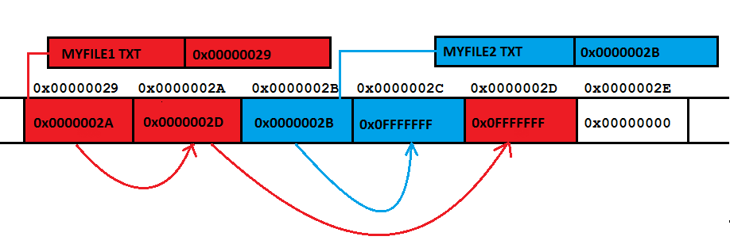

Slide 73
OK! Then how it works!!!
Kernel code checks for volumes
Uses Entries in PT & signatures in Boot sector to identify the type
Loads appropriate code (ALGORITHMS)
This code mounts the file system at some specific point (Drive in Win, Folder in *nix)
Creates in-core structures to map on-disk structures

Slide 74
File System Structure
fopen(“c:\abc\abc.txt”)
Directory Module
File Module
Access Control Module
File Access Module
Block Module
Device Module
Maps File Names to File IDs
Maps File IDs to actual files
Validates the access
Reads & Writes Data/Metadata
Allocates & Accesses Disk Blocks
Disk I/O, I/O level caching

Slide 75
Reading Assignment
Papers:
A Quick Review of On-Disk Layout of Some Popular Disk File Systems
By Wasim Ahmad Bhat & SMK Quadri
Review of FAT Data Structure of FAT32 file system
By Wasim Ahmad Bhat & SMK Quadri

Slide 76
Distributed File Systems
Unit 3

Slide 77
What is DFS?
It is a client/server-based application that allows clients to share, access and process data stored on the server(s) as if it were on their own computer.
What about FTP?
User gets copy of the file!
Needs to know address of the server!!
Is it a concrete file system?
Generally NO!!!

Slide 78
DFS - goals
Goal:
To provide common view of centralized file system, but distributed implementation.
Ability to open & update any file on any machine on network
Handle all synchronization issues and capabilities of shared local files
Thus, the goal is to manage a set of dispersed storage devices to look & work like one.

Slide 79
DFS - Requirements
Basically only two:
access transparency, and
location transparency
However, other requirements have become mandatory;
performance,
scalability,
concurrency control,
fault tolerance, and
security

Slide 80
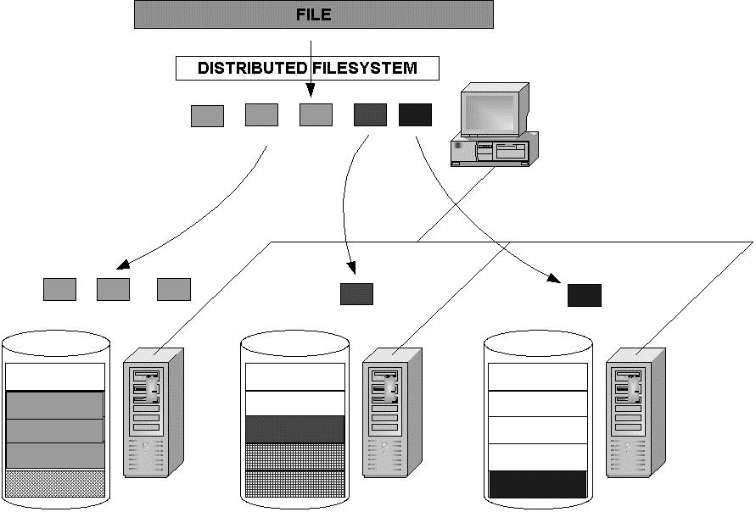
Client Computer
Servers may be running 3 different concrete file systems (FAT, ext4, LFS) on top of which DFS runs
Server 3
Server 1
Server 2

Slide 81
What about naming?
3 schemes:
combination of host and local name
guarantees a unique name
But NOT location transparent & location independent.
DFS is a loose collection of independent file systems.
E.g. Windows Network
Mount remote directories to local directories
Coherent directory structure & location independent
E.g. Unix/Linux with NFS; Windows with mapped drives
Total integration of component file systems.
A single global name structure spans all the files in the system.

Slide 82
A Comparison
Sharing
Persistence
Distributed
Consistency
Example
cache/replicas
maintenance
Main memory
1
RAM
File system
1
UNIX file system
Distributed file system
Sun NFS
Web
Web server

Slide 83
File Service
A file service is a specification of what the file system offers to clients.
A file server is the implementation of a file service and runs on one or more machines.

Slide 84
DISTRIBUTED File Service Requirements
Transparency
Concurrency
Replication
Heterogeneity
Fault tolerance
Consistency
Security
Efficiency

Slide 85
Transparency
Access:
Local/Remote file should be accessed in the same manner
Mobility:
Automatic relocation of files should be possible
Location:
Same namespace after relocation of files
Performance:
Programs should continue to perform satisfactorily
Scaling:
Expanding the service to meet additional loads should be transparent

Slide 86
Concurrency
File-level or record-level locking
Other forms of concurrency control

Slide 87
Replication
For better load-sharing & response, multiple identical copies of files may be maintained

Slide 88
Heterogeneity
Service can be accessed by clients running on (almost) any OS or hardware platform.
Design must be compatible with the file systems of different OSes
Service interfaces must be open
precise specifications of APIs are published.

Slide 89
Fault tolerance
Service must continue to operate even when clients make errors or crash.
Service must resume after a server machine crashes.
If the service is replicated, it can continue to operate even during a server crash.

Slide 90
Consistency
Unix offers one-copy update semantics for operations on local files.
Single cached copy
Difficult to achieve the same for distributed file systems while maintaining good performance and scalability.
Multiple caches (performance)
Multiple physical copies (scalability & reliability)

Slide 91
Security
Must maintain access control and privacy as for local files.
based on identity of user making request
Identities of remote users must be authenticated
Privacy requires secure communication
Service interfaces are open to all processes not excluded by a firewall.
vulnerable to impersonation and other attacks

Slide 92
Efficiency
Goal for distributed file systems is to perform comparable to local file system.

Slide 93
Reading Assignment
Distributed systems: principles and paradigms
by AST & MV Steen
Chapter 5
5 Distributed File Systems
5.1. DISTRIBUTED FILE SYSTEM DESIGN
5.1.1. The File Service Interface
5.1.2. The Directory Server Interface
Naming Transparency
Two-Level Naming
5.1.3. Semantics of File Sharing

Slide 94
Dis. FILE SERVICE COMPONENTS
Unit 3

Slide 95
DISTRIBUTED File Service COMPONENTS
Structuring the file service as three components:
A flat file service
A directory service
A client module.

Slide 96
DISTRIBUTED File Service COMPONENTS
Client computer
Server computer
Application
Directory service
Application
Flat file service
Client module

Slide 97
Flat File Service
Concerned with the implementation of operations on the contents of file.
Unique File Identifiers (UFIDs) are used to refer to files in all requests for flat file service operations.
UFIDs are long sequences of bits chosen so that each file has a unique number among all of the files in a distributed system.

Slide 98
Directory Service
Provides mapping between text names for the files and their UFIDs.
Clients may obtain the UFID of a file by quoting its text name to directory service.
Directory service supports functions needed generate directories, to add new files to directories.

Slide 99
Client Module
It runs on each computer and provides integrated service (flat file and directory) as a single API to application programs.
For example, in UNIX hosts, a client module emulates the full set of Unix file operations.
It holds information about the network locations of flat-file and directory server processes.

Slide 100
Dis. FILE SERVICE TYPES
Unit 3

Slide 101
File Models
Structured vs Unstructured
Un-Structured – Stream of bytes
Structured - Stream of records
Mutable vs Immutable
In-place updates
Out-of-place updates

Slide 102
File Accessing Models
Remote Service Model
Data-Caching Model
Cache consistency problem
Upload/Download Model

Slide 103
Data Transfer Models
File-Level Transfer
Block Level Transfer
Record Level Transfer
Byte Level Transfer

Slide 104
OTHER DFS design considerations
Unit 3

Slide 105
CACHE CONSISTENCY
Reduce network traffic by retaining recently accessed disk blocks in local cache
In memory cache
Small files, diskless workstations
In disk cache
Large files, sustains server failure
Cache-consistency problem
keeping the cached copies consistent with the master file, especially on write operations

Slide 106
Cache update
Write through
Reliable but hinders performance
Delayed-write
Write operations complete quickly;
some data may be overwritten in cache, saving needless network I/O.
Poor reliability
unwritten data may be lost when client machine crashes
Inconsistent data
Solution: scan cache at regular intervals and flush dirty blocks

Slide 107
SERVER SEMANTICS
Stateless Service
Avoids maintaining state information in server by making each request self-contained.
No need to establish and terminate a connection by open and close operations.
Poor support for locking or synchronization among concurrent accesses
E.g. NFS

Slide 108
SERVER SEMANTICS
Stateful Service
Client opens a file (as in Unix & Windows).
Server fetches information about file from disk, stores in server memory,
Returns to client a connection identifier unique to client and open file.
Identifier used for subsequent accesses until session ends.
Server must reclaim space used by no longer active clients.
Increased performance; fewer disk accesses.

Slide 109
REPLICATION
Replicas of the same file reside on independent machines.
Improves availability and can shorten service time.
Naming scheme maps a replicated file name to a particular replica.
Existence of replicas should be invisible to higher levels.
Replicas must be distinguished from one another by different lower-level names.
Updates
Replicas of a file denote the same logical entity
Update to any replica must be reflected on all other replicas.

Slide 110
SUN NFS
Unit 3

Slide 111
SUN-NFS : A Distributed file system
Developed by Sun Microsystems in the 1980s to allow any computer to access files residing on any other computer connected via a network.
The motivation
share files across heterogeneous machines.
The design goal
provide this service without having to modify, or even recompile, programs accessing these files.
In addition, Unix file access semantics and reasonable performance had to be ensured.

Slide 112
SUN-NFS : Architecture
It consists of three software components:
one that resides on top of some concrete file system (such as UFS) on the server and exports directories as NFS shares to clients;
another that hooks to the Virtual File System (VFS) on the client machine to abstract the NFS share on the server as a local concrete file system;
and finally, the communication protocol between the NFS server and NFS client.

Slide 113
SUN-NFS : Architecture

Slide 114
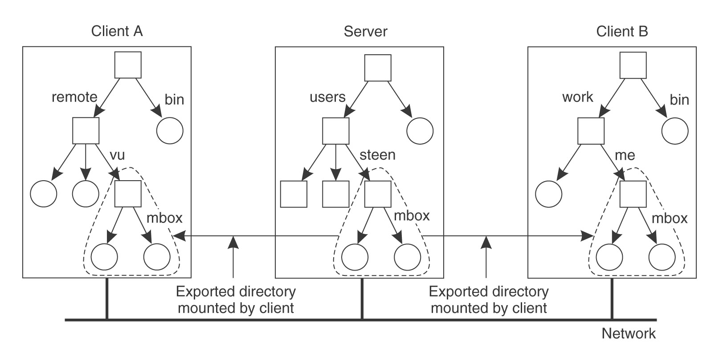
SUN-NFS: AN EXAMPLE
Server A sees : /users/ steen/mbox
Client A sees: /remote/vu/ mbox
Client B sees: /work/me/ mbox

Slide 115
Reading Assignment
Distributed systems: principles and paradigms
by AST & MV Steen
Chapter 5
5.2. DISTRIBUTED FILE SYSTEM IMPLEMENTATION
5.2.1. File Usage
5.2.2. System Structure
5.2.3. Caching Cache Consistency
5.2.4. Replication Update Protocols
5.2.5. An Example: Suns Network File System NFS Architecture NFS Protocols NFS Implementation
5.2.6. Lessons Learned

Slide 116
References
Books:
Distributed systems: principles and paradigms
by AST & MV Steen
Distributed OS (Concepts & Design)
by PK Sinha
Papers:
A SURVEY OF DISTRIBUTED FILE SYSTEMS
by M. Satyanarayanan
The design & implementation of SUN NFS
by Sandberg et al.
Understanding and mitigating security issues in Sun NFS
by Wasim A.B. & S.M.K. Quadri

